Slide 1
INSTAGRAM REACH ANALYSIS
Team Members:
Sarika M N (1DB21CI086)
Nisarga M (1DB21AD030)
Vaishnavi K S (1DB21AD052)
Notes:
Note:

Slide 2
INSTAGRAM REACH ANALYSIS
UNIT 1. Problem Statement
Notes:
Note:

Slide 3
INSTAGRAM REACH ANALYSIS
UNIT 2. Data Set Involved
Notes:
Note:

Slide 4
INSTAGRAM REACH ANALYSIS
UNIT 3. Data Analysis and Visualization Concepts Applied
1. DataFrames:
-It allows for easy storage and manipulation of structured data, making it a popular choice for data cleaning, preparation, and analysis tasks.
2. Data Cleansings:
-The process of identifying and correcting errors, inconsistencies, and inaccuracies in a dataset to improve its quality and reliability.
3. Analyzing the relationship:
-Analyzing the relationship between the number of likes a,number of comments ,number of shares and number of saves and the number of impressions using as scatter chart.
4. Wordclouds:
-Wordclouds are used used to visualize the most used words in captions ofInstagram posts hashtags in Instagram posts.
5. Seaborn:
-It is a Python data visualization library built on top of Matplotlib, offering an easy-to-use API for creating attractive statistical graphics and providing beautiful default styles.
Notes:
Note:

Slide 5
INSTAGRAM REACH ANALYSIS
UNIT 4. Outcomes
1.Read the data from csv file.
2.Handling Missing values.
3.Distribution of impressions received from home section.
4.Distribution of impressions received from Hashtags.
5. Distribution of impressions received from Explore section.
6.Analyzation of percentage of impressions received from various sources.
7.Wordcloud of captions.
8.Wordcloud of hashtags.
9.Relationship between Likes and Impressions.
10.Relationship between Comments and Impressions.
11.Relationship between Shares and Impressions.
12.Relationship between Saves and Impressions.
Notes:
Note:

Slide 6
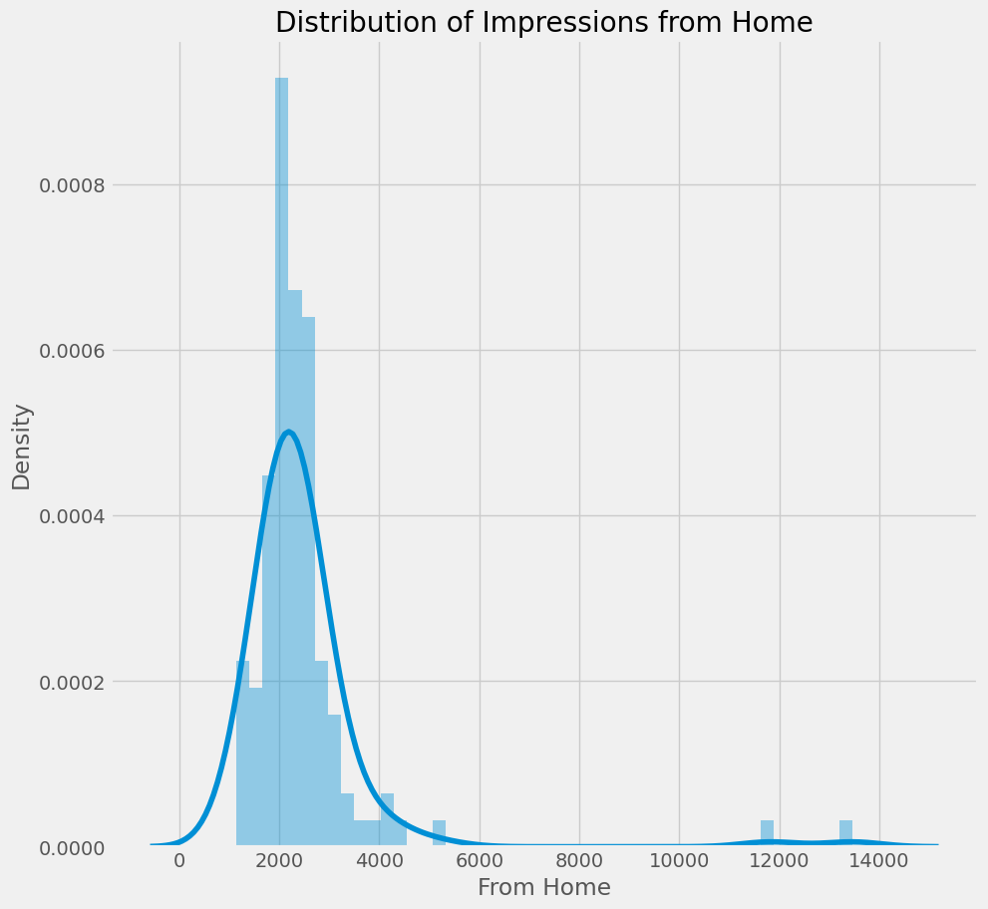
INSTAGRAM REACH ANALYSIS
Visualization
Notes:
Note:

Slide 7
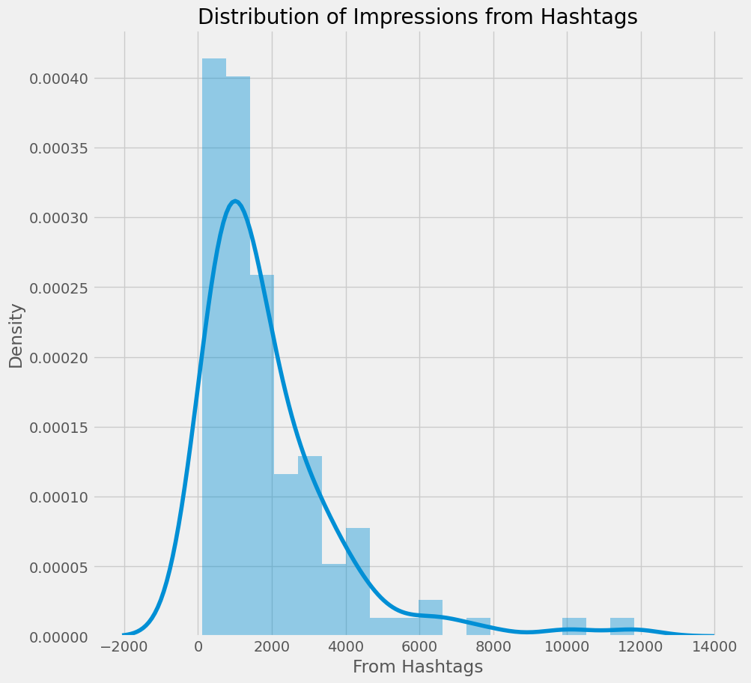
INSTAGRAM REACH ANALYSIS
Visualization
Notes:
Note:

Slide 8
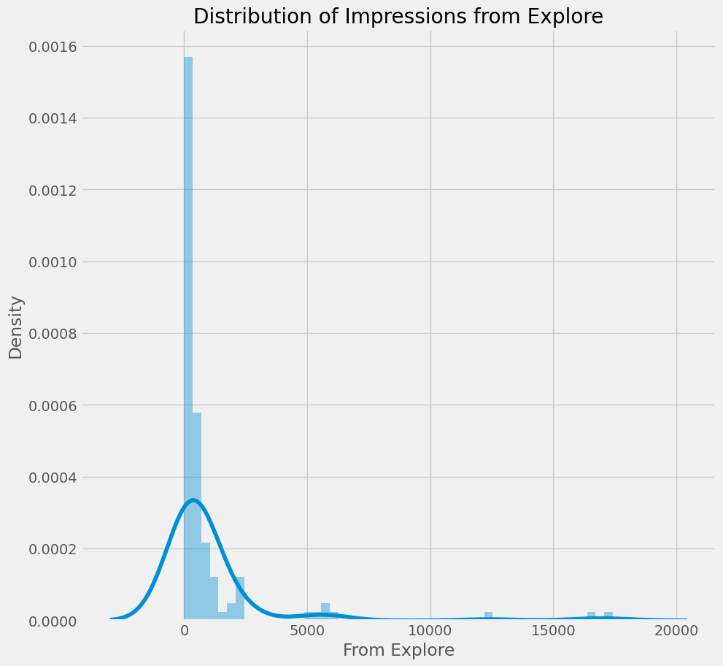
INSTAGRAM REACH ANALYSIS
Visualization
Notes:
Note:

Slide 9
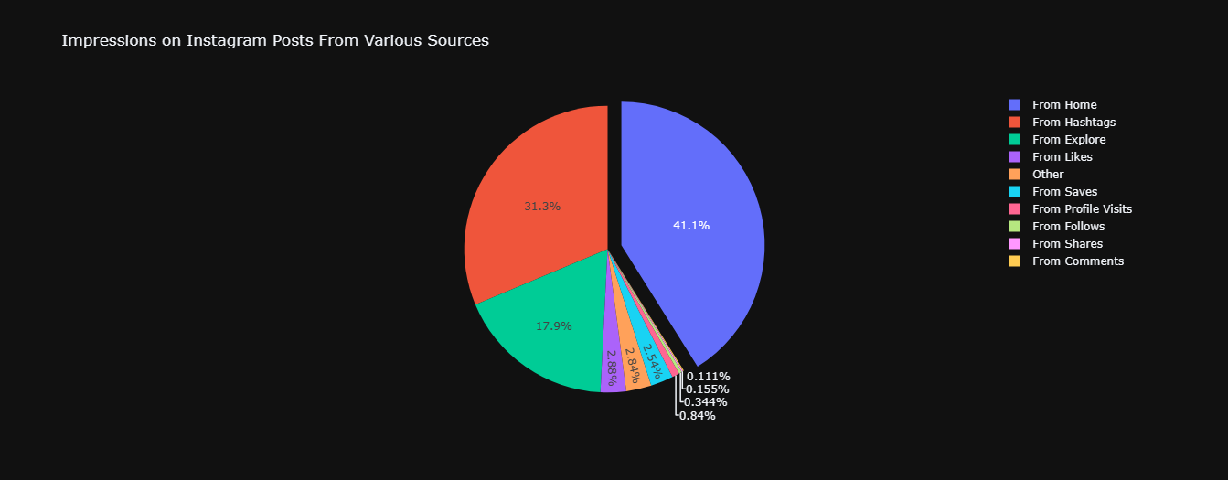
INSTAGRAM REACH ANALYSIS
Visualization
Notes:
Note:

Slide 10
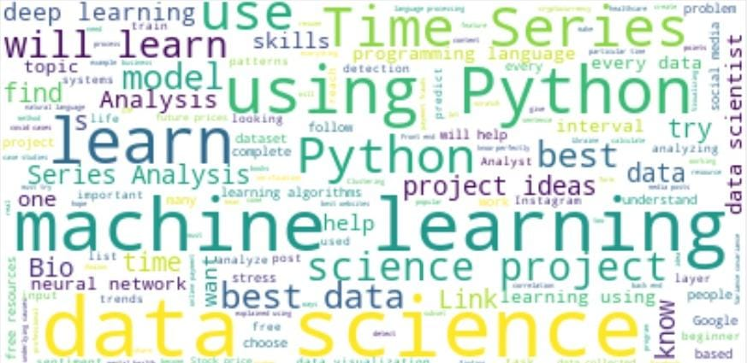
INSTAGRAM REACH ANALYSIS
Visualization
WordCloud of captions
Notes:
Note:

Slide 11
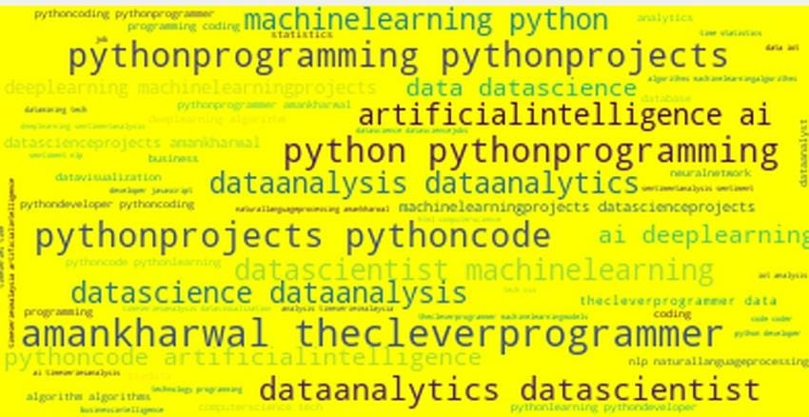
INSTAGRAM REACH ANALYSIS
Visualization
WordCloud of the hashtags
Notes:
Note:

Slide 12
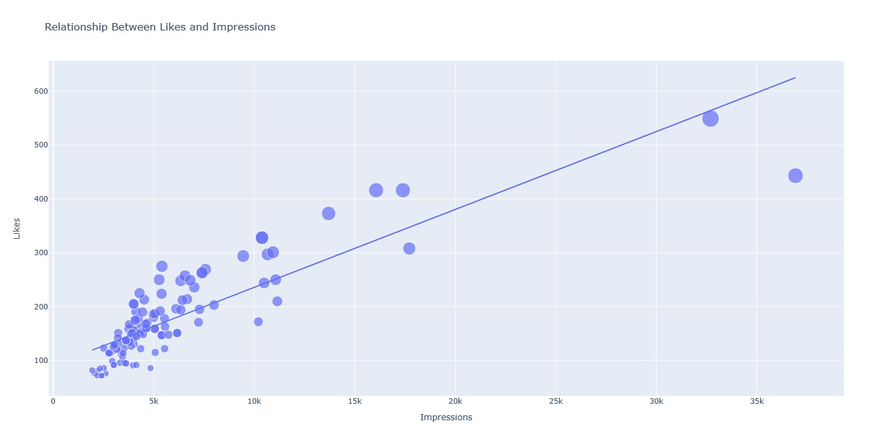
INSTAGRAM REACH ANALYSIS

Slide 13
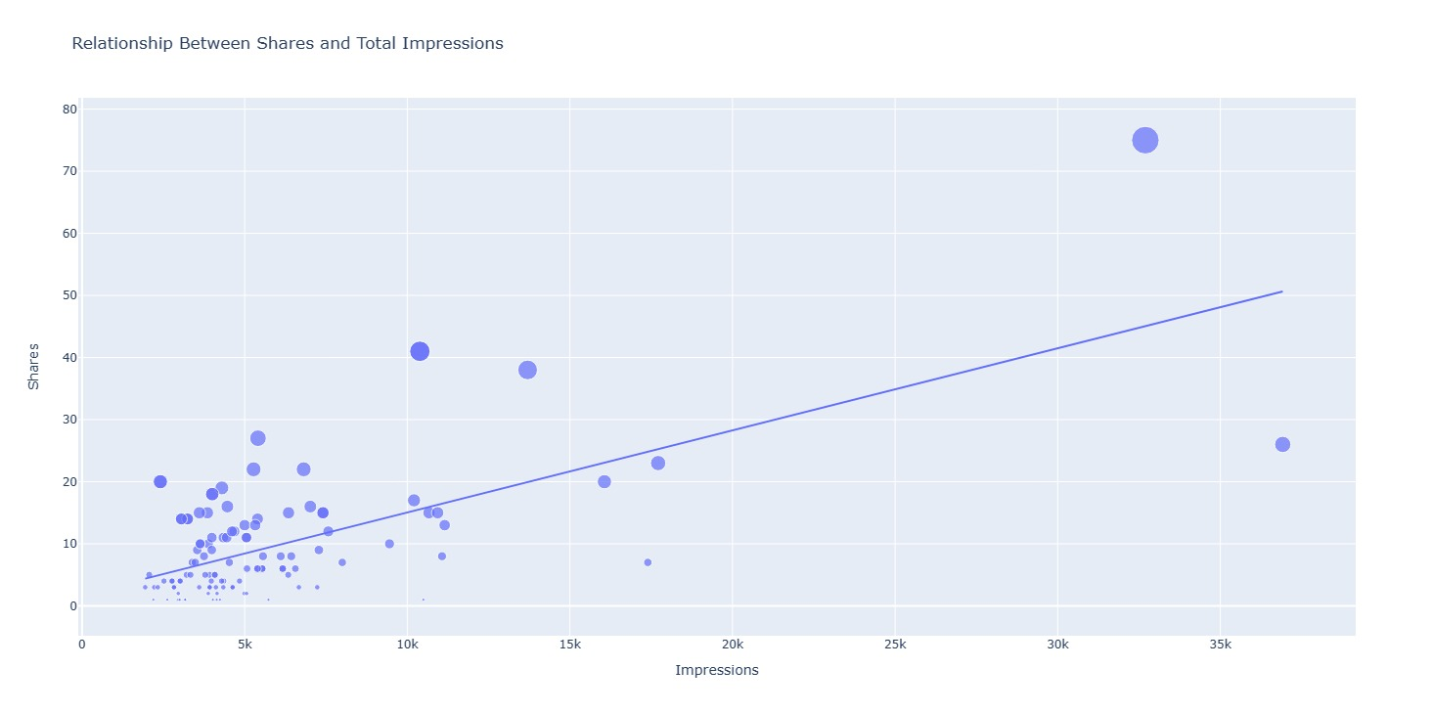
INSTAGRAM REACH ANALYSIS

Slide 14
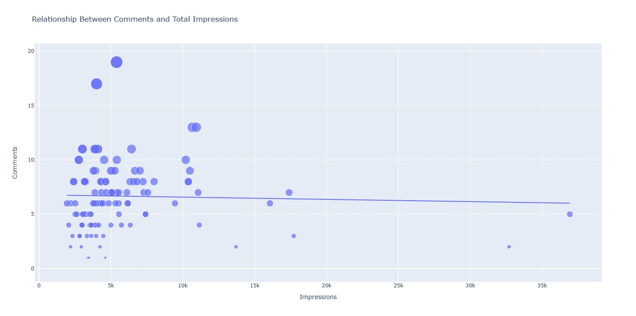
INSTAGRAM REACH ANALYSIS

Slide 15
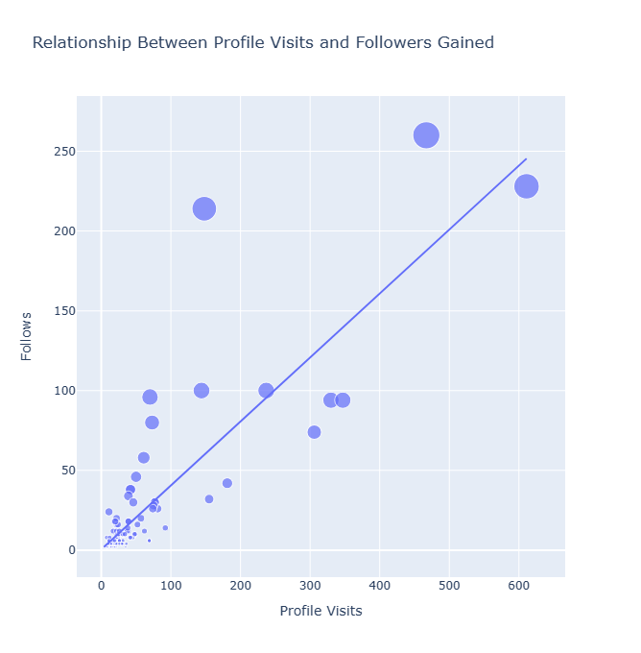
INSTAGRAM REACH ANALYSIS

Slide 16
INSTAGRAM REACH ANALYSIS
Conclusion
In this analysis, we explored an Instagram dataset to gain insights into the impressions and engagement of posts. this comprehensive analysis provided valuable insights into the impressions and engagement of Instagram posts. The visualizations and relationships explored shed light on various factors influencing post visibility and engagement on the platform. This information can be utilized by social media marketers, content creators, and businesses to optimize their Instagram strategies and improve audience reach and engagement.
Notes:
Note:

Slide 17
INSTAGRAM REACH ANALYSIS
Conclusion
Here is the breakdown of project contributions for the tasks:
Vaishnavi : Read the data from the csv file.
Sarika : Checked for null / nan values in the given data set
Nisarga : Analyzed the distribution of impressions received from home using seaborn package.
Vaishnavi : Analyzed the distribution of impressions received from home using seaborn packages.
Sarika : Analyzed the distribution of impressions received from hashtags using seaborn packages.
Nisarga : Analyzed the percentage of impressions received from various sources using pie chart.
Vaishnavi : Created a wordcloud of the most used words in the captions of Instagram posts.
Sarika : Created a wordcloud of the most used words in the hashtags of Instagram posts.
Nisarga : Analyzed the relationship between the number of likes and impressions on Instagram posts using a scatter chart.
Notes:
Note:

Slide 18
INSTAGRAM REACH ANALYSIS
Conclusion
Here is the breakdown of project contributions for the tasks:
Vaishnavi : Analyzed the relationship between the number of comments and impressions on Instagram posts using a scatter chart.
Sarika : Analyzed the relationship between the number of shares and impressions on Instagram posts using a scatter chart.
Nisarga : Analyzed the relationship between the number of saves and impressions on Instagram posts using a scatter chart.
Notes:
Note:

